Slide 1
Ch 6: ER to Relational Mapping
Much of the material presented in these slides was developed by Dr. Ramon Lawrence at the University of Iowa

Slide 2
ER Model to Relational Schemas
These notes will describe how to convert an ER diagram into a corresponding relational schema.
Conceptual database design produces a conceptual ER model. This conceptual model is then converted into the relational model (which is a logical model).
Note that although it is possible to design using the relational model directly, it is normally more beneficial to perform conceptual design using the ER model first.

Slide 3
ER Model to Relational Schemas
Converting an ER model to a relational database schema involves 7 steps.
In general, these steps convert entities to relations and ER relationships to relations. For 1:1 and 1:N relationships, foreign keys can be used instead of separate relations.
Handling subclasses and superclasses requires an extra conversion step.
After conversion is performed, normalization and optimization are often performed to improve the relational schema.

Slide 4
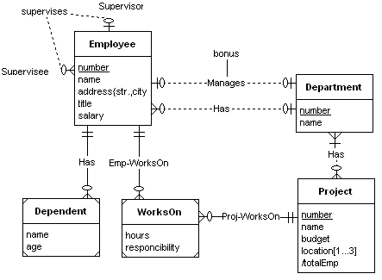
ER Model Example

Slide 5

Step #1: Convert Strong Entities
Step #1: Convert each strong entity to a relation.
Employee (eno, ename, state, city, street, title, salary)
  Notes:
  Attributes of the entity type become attributes of the relation.
  Include only simple attributes in relation. For composite attributes, only create attributes in the relation for their simple components.
  Multi-valued attributes are handled separately (in step #6).
  The primary key of the relation is the key attributes for the entity.

Slide 6
Current Relational Schema - Step #1
Employee (eno, ename, state, city, street, title, salary)
Department (dno, dname)
Project (pno, pname, budget)

Slide 7
Step #2: Convert Weak Entities
Step #2: Convert each weak entity into a relation with foreign keys to its identifying relations (entities).
For each weak entity W with identifying owners E1, E2, …, En create a relation R:
  Identify relations R1, R2, …, Rn for entity types E1, E2, …, En.
  The primary key of R consists of the primary keys of R1, R2, …, Rn plus the partial key of the weak entity.
  Create a foreign key in R to the primary key of each relation R1, R2, …, Rn.
  Attributes are converted the same as strong entities.

Slide 8
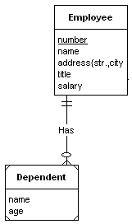
Step #2: Convert Weak Entities--Example
Employee (eno, ename, state, city, street, title, salary)
Dependent (eno, name, age)

Slide 9
Current Relational Schema- Step #2
Department (dno, dname)
Dependent (eno, name, age)
Employee (eno, ename, state, city, street, title, salary)
WorksOn (eno, pno, responcibility, hours)
Project (pno, pname, budget)

Slide 10
ER to Relational Mapping
Steps #3-5: Convert Relationships
Steps 3 to 5 convert binary relationships of cardinality:
  1:1 - Step #3
  1:N - Step #4
  M:N - Step #5
Note that M:N relationships are the most general case, and the conversion algorithm for these relationships can be applied to 1:1 and 1:N as well.
  However, for performance reasons, it is normally more efficient to perform different conversions for each relationship type.
  In general, each ER relationship can be mapped to a relation. However, for 1:1 and 1:N relationships, it is more efficient to combine the relationship with an existing relation instead of creating a new one.
Relationships that are not binary (if there are any) are handled in step #7.

Slide 11
ER to Relational Mapping
Step #3: Convert 1:1 Relationships
Step #3: Convert binary 1:1 relationships into a UNIQUE foreign key reference from one relation to the other.
Given a binary 1:1 relationship R between two entities Ei and Ej:
  Identify the corresponding relations Ri and Rj.
  Chose one of the relations, say Ri, and:
    Add the attributes of R to Ri.
    Add the primary key attributes of Rj to Ri, and create a foreign key reference to Rj from Ri.
    Declare these primary key attributes of Rj to be UNIQUE.
  Notes:
    You can select either Ri or Rj. Typically, it is best to select the relation that is guaranteed to always participate in the relationship or the one that will participate the most in the relationship.

Slide 12
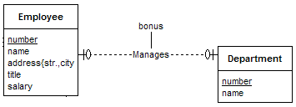
ER to Relational Mapping
Step #3: Convert 1:1 Relationships
Manages (eno, dno, bonus)
Department (dno, dname)
Employee (eno,
ename, state, city,
street, title, salary)
Department (dno, dname, mgreno, bonus)
Note: Renamed eno to mgreno for clarity.

Slide 13
ER to Relational Mapping
Step #4: Convert 1:N Relationships
Step #4: Convert binary 1:N relationships into a foreign key reference from the N-side relation to the 1-side relation.
Given a binary 1:N relationship R between two entities Ei and Ej:
  Identify the corresponding relations Ri and Rj.
  Let Ri be the N-side of the relation.
  Add the attributes of R to Ri.
  Add the primary key attributes of Rj to Ri, and create a foreign key reference to Rj from Ri.
Notes:
  Unlike 1:1 relationships, you must select the N-side of the relationship as the relation containing the foreign key and relationship attributes.

Slide 14
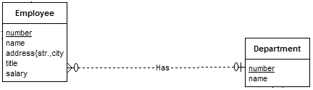
ER to Relational Mapping
Step #4: Convert 1:N Relationships
Employee (eno,
ename, state, city,
street, title, salary)
inDept (dno, eno)
Department (dno, dname, mgreno, bonus)
Employee (eno, ename, state, city, street, title, salary, dno)

Slide 15
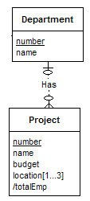
ER to Relational Mapping
Step #4: Convert 1:N Relationships
Department (dno, dname, mgreno, bonus)
deptProj (dno, pno)
Project (pno, pname, budget, dno)
Project (pno, pname, budget)

Slide 16
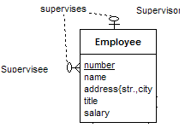
ER to Relational Mapping
Step #4: Convert 1:N Relationships
Supervises (supereno, eno)
Employee (eno, ename, state, city, street,
title, salary, dno)
Employee (eno, ename, state, city, street,
title, salary, dno, supereno)

Slide 17
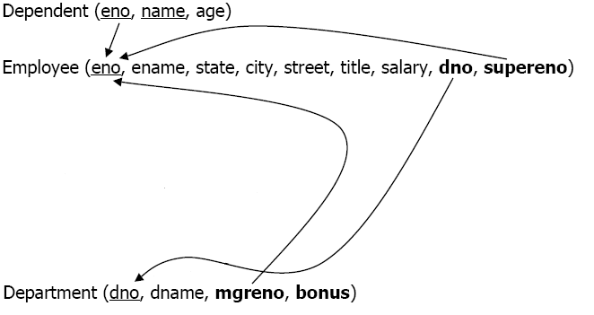
ER to Relational Mapping
Current Relational Schema - Step #4
WorksOn (eno, pno, responcibility, hours)
Project (pno, pname, budget, dno)

Slide 18
ER to Relational Mapping
Step #5: Convert M:N Relationships
Step #5: Convert binary M:N relationships into a new relation with foreign keys to the two participating entities.
Given a binary M:N relationship between entities Ei and Ej:
  Identify the corresponding relations Ri and Rj.
  Create a new relation R representing the relationship where:
  R contains the relationship attributes.
  The primary key of R is a composite key consisting of the primary keys of Ri and Rj.
  Add the primary key attributes of Ri and Rj to R, and create a foreign key reference to Ri from R and to Rj from R.

Slide 19
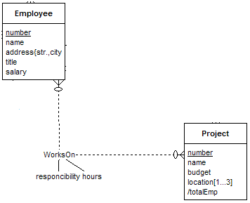
ER to Relational Mapping
Step #5: Convert M:N Relationships
Alternative representation of
WorksOn relationship
Employee (eno,
ename, state, city,
street, title, salary,
dno, supereno)
Project (pno, pname, budget, dno)
WorksOn (eno, pno, resp, hours)

Slide 20
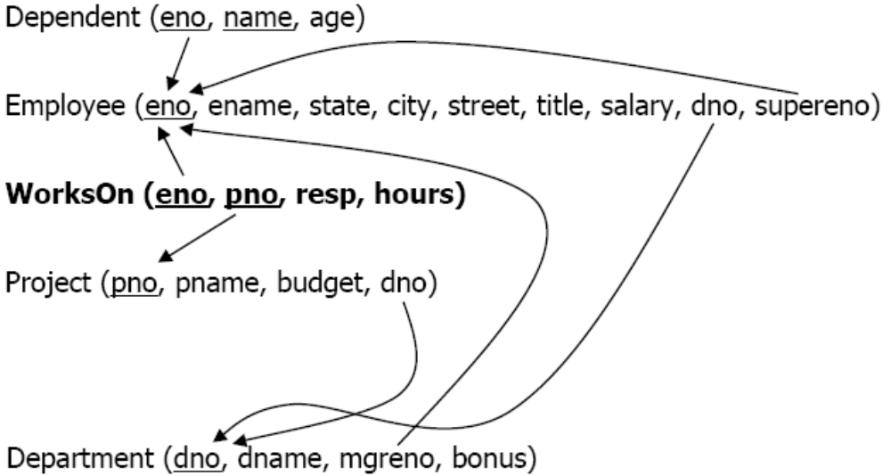
ER to Relational Mapping
Current Relational Schema - Step #5

Slide 21
ER to Relational Mapping
Step #6: Convert Multi-Valued Attributes
Step #6: Convert a multi-valued attribute into a relation with composite primary key consisting of the attribute value plus the primary key of the attribute's entity.
Given a multi-valued attribute A of entity Ei:
  Identify the corresponding relation Ri.
  Create a new relation R representing the attribute where:
    R contains the simple, single-valued attribute A.
    Add the primary key attributes of Ri to R, and create a foreign key reference to Ri from R.
    The primary key of R is a composite key consisting of the primary key of Ri and A.

Slide 22
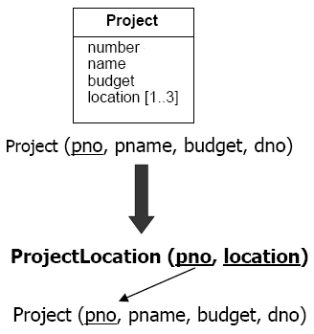
ER to Relational Mapping
Step #6: Convert Multi-Valued Attributes

Slide 23
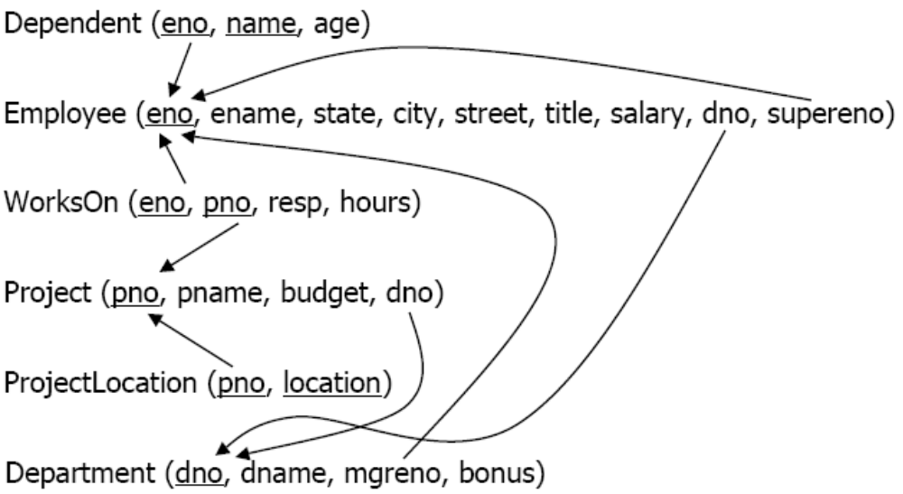
ER to Relational Mapping
Final Relational Schema

Slide 24
ER to Relational Mapping
Step #7: Convert n-ary Relationships
Step #7: Convert n-ary relationships by creating a new relation to represent the relationship and creating foreign keys that reference the related entities.
Given an n-ary relationship between entities E1, E2, …, En:
  Identify relations R1, R2, …, Rn for entity types E1, E2, …, En.
  Create a new relation R to represent the relationship.
  The primary key of R consists of the primary keys of R1, R2, , Rn.
  Create a foreign key in R to the primary key of each relation 1, R2, …, Rn.
  Attributes of the relationship become attributes of R.

Slide 25
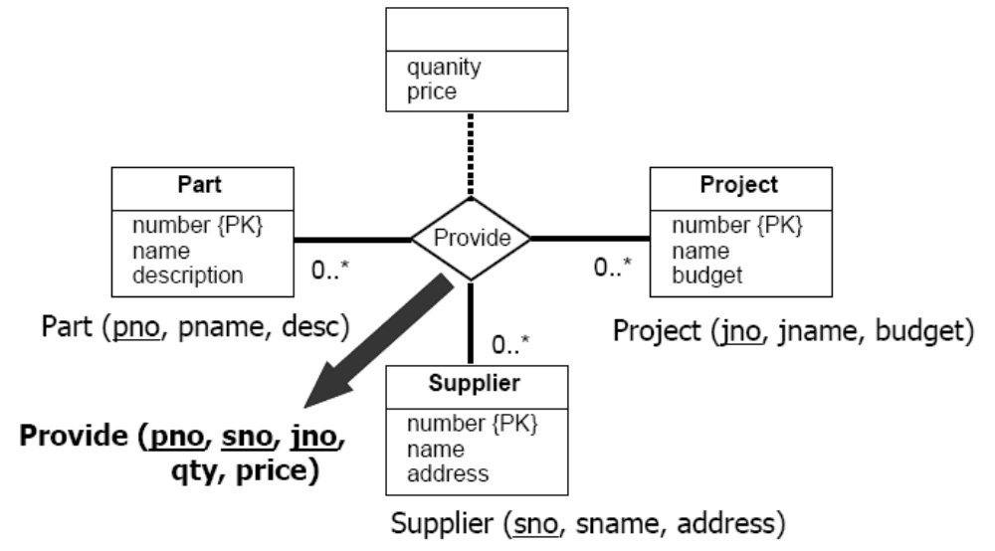
ER to Relational Mapping
Step #7: Convert n-ary Relationships

Slide 26
ER to Relational Mapping:
Converting Generalization Hierarchies
An additional step is necessary to convert subclasses and superclasses to the relational model.
In general, we have several different approaches:
  1) Create a separate relation for each superclass and subclass
    Most general technique that we will use.
  2) Create relations for subclass only.
    Only works if superclass has mandatory participation.
  3) Create a single relation with one type attribute.
    Attribute is used to indicate the type of object (subclass) in the row.
    Works only if the subclasses are disjoint.
  4) Create a single relation with multiple type attributes.
    Have a boolean valued attribute for each subclass. True if in subclass.
    Works if subclasses may be overlapping.

Slide 27
ER to Relational Mapping
Step #8: Convert Subclasses
Step #8: Convert subclasses and superclasses by creating a relation for each subclass and superclass. Link the subclasses to the superclass using foreign key references.
Given a superclass C and set of subclasses S1, S2, …, Sn:
  Create a relation R for C.
  The primary key for R is the primary key of the superclass.
  Create relations R1, R2, …, Rn for subclasses S1, S2, …, Sn.
  The primary key for each Ri is the primary key of the superclass.
  For each Ri, create a foreign key to R using the primary key attributes.

Slide 28
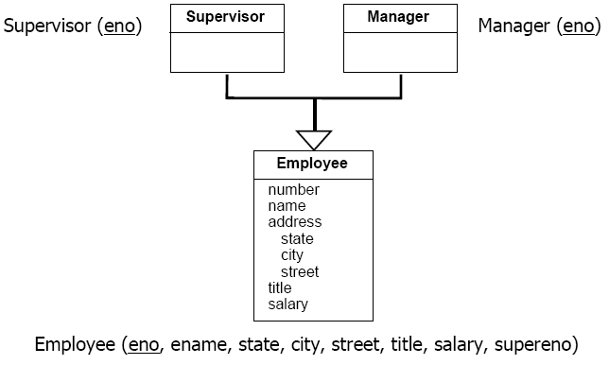
ER to Relational Mapping
Step #8: Convert Subclasses

Slide 29
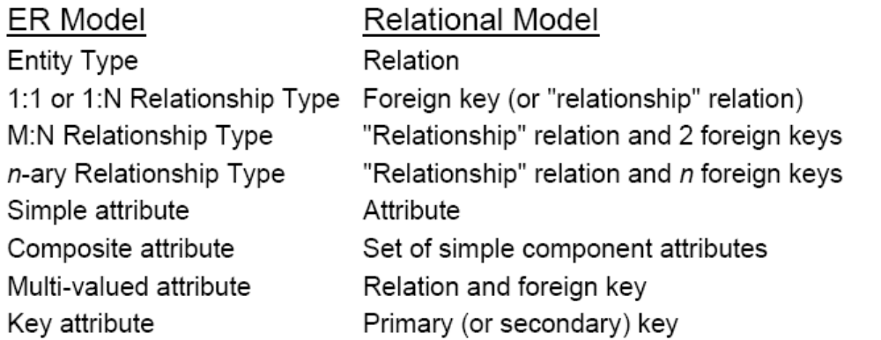
Summary of ER to Relational Mapping

